Slide 1

SYLLOGISM
LOGICAL REASONING

Slide 2
SYLLOGISMS/DEDUCTIONS
Syllogism comes from the Greek word "syllogismos", meaning conclusion or inference. It involves drawing conclusions from given statements using deductive reasoning.
Questions in this section present two or more statements, followed by two or more conclusions. The task is to determine which conclusions logically follow, assuming all statements are true, even if they contradict common facts.
The most effective method for solving syllogisms is using Venn diagrams. One should draw all possible diagrams based on the statements, analyze each, and select the conclusion(s) common to all diagrams as the correct answer.

Slide 3
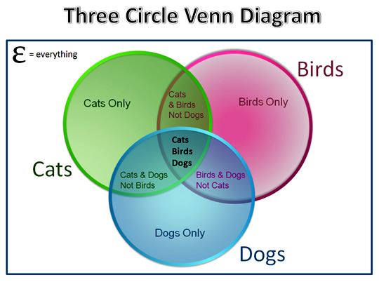
Venn diagram
Venn diagrams are pictorial representations of sets using geometrical shapes. A combined diagram is used to represent all given statements.
Each set of statements can be represented in multiple valid ways using Venn diagrams. A conclusion is said to definitely follow only if it holds true in all possible diagrams.

Slide 4
Qualifiers in Syllogism
Qualifier | Form | Example
All | All A are B | All animals are living things
No | No A is B | No boy is a girl
Some | Some A are B | Some doctors are men
Some Not | Some A are not B | Some cricketers are not Indians

Slide 5
EQUIVALENT PHRACES
Qualifier | Alternate Forms
All A are B | Each A is B, Every A is B, Any A is B, A's are B
Some A are B | A few A are B, Many A are B, At least some A are B, Some A are definitely B
No A is B | None of the A are B, A can never be B, A is not B
Some A are not B | Some A can never be B, Some A are definitely not B, All A cannot be B

Slide 6
Type of Statements
Complementary Pairs
Pair 1 All & Some-not
Pair 2 No & Some
Type | Qualifiers Used
Affirmative | All, Some
Negative | No, Some-not

Slide 7
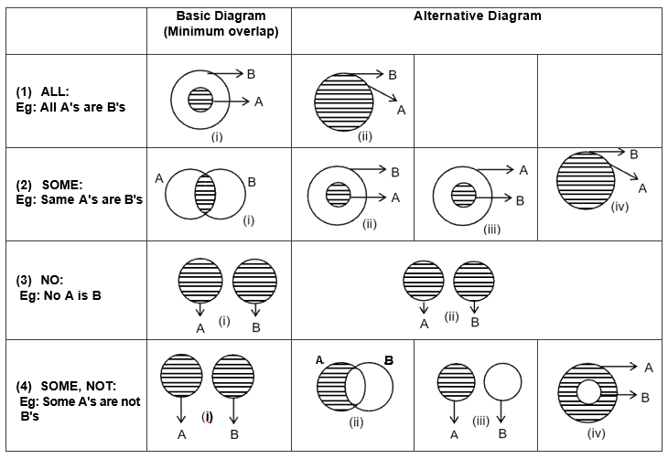
Basic diagram & alternate diagram

Slide 8
1) Statements:
All hexagons are pentagons.
All pentagons are squares.
Conclusions:
I.All hexagons are squares.
II.All squares are hexagons.
if only I follows.
if only II follows.
if either I or II follows.
if neither I nor II follows.
if both I and II follow.

Slide 9
2) Statements:
All students are employees.
Some students are teachers.
Conclusions:
I.Some employees are teachers.
II.All teachers are employees.
if only I follows.
if only II follows.
if either I or II follows.
if neither I nor II follows.
if both I and II fallow.

Slide 10
3) Statements:
Some kids are males.
Some males are babies.
Conclusions:
I.All kids are babies.
II.No kid is a baby.
if only I follows.
if only II follows.
if either I or II follows.
if neither I nor II follows.
if both I and II follow.

Slide 11
4) Statements:
All ladders are mats.
All ladders are prisms.
Conclusions:
I.Some mats are prisms.
II. No mat is a prism.
if only I follows.
if only II follows.
if either I or II follows.
if neither I nor II follows.
if both I and II follow.

Slide 12
5) Statements:
All theorems are therapies.
Some therapies are sponges.
Conclusions:
I.No theorem is a sponge.
II. Some theorems are sponges.
if only I follows.
if only II follows.
if either I or II follows.
if neither I nor II follows.
if both I and II follow.

Slide 13
6) Statements:
All photos are poems.
No poem is a picture.
Conclusions:
I.Some photos are pictures.
II.No photo is a picture.
if only I follows.
if only II follows.
if either I or II follows.
if neither I nor II follows.
if both I and II follow.

Slide 14
7) Statements:
All kilobytes are megabytes.
Some kilobytes are not gigabytes.
Conclusions:
I.No megabyte is a gigabyte.
II.Some megabytes are not gigabytes.
if only I follows.
if only II follows.
if either I or II follows.
if neither I nor II follows.
if both I and II follow.

Slide 15
8) Statements:
All erasers are pencils.
All pens are pencils.
Some pens are sharpeners.
Conclusions:
I.Some erasers are pens.
II.Some pencils are sharpeners.
if only I follows.
if only II follows.
if either I or II follows.
if neither I nor II follows.
if both I and II follow.

Slide 16
9) Statements:
All employees are graduates.
Some graduates are students.
All students are guardians.
Conclusions:
I.At least some graduates are guardians.
II.Some employees are students.
if only I follows.
if only II follows.
if either I or II follows.
if neither I nor II follows.
if both I and II follow.

Slide 17
10) Statements:
All oceans are continents.
Some continents are countries.
No country is a lake.
Conclusions:
I. All lakes are continents.
II. Some lakes are not continents.
if only I follows.
if only II follows.
if either I or II follows.
if neither I nor II follows.
if both I and II follow.

Slide 18
11) Statements:
No king is a queen.
No queen is a prince.
No prince is brave.
Conclusions:
I. No king is prince.
II. Some queens are not brave.
if only I follows.
if only II follows.
if either I or II follows.
if neither I nor II follows.
if both I and II follow.

Slide 19
12) Statements:
Some cookers are machines.
Some machines are not ovens.
All ovens are televisions.
Conclusions:
I.Some televisions are definitely not machines.
II. All televisions are machines.
III. No cooker is oven.
Only III and either I or II follows.
Only I follows.
Both I and II follow.
Either I or II follows.
None follows.

Slide 20
13) Statements:
No holder is a hanging.
All berths are hangings.
Some hangings are tables.
Conclusions:
I.No holder is a berth.
II. At least some berths are tables.
III. Some tables can never be holders.
Both I and II follow.
Both I and III follow.
Both II and III follow.
All follow.
None follows.

Slide 21
14) Statements:
All dollars are rupees.
Only a few rupees are euro.
Some dollars are pound.
Conclusions:
I.Some rupees are pound
II. No euro is a dollars.
III. All pound are euro.
Only II follows.
Only I follows.
Only II and III follows.
All follows.
None follows.

Slide 22
15) Statements:
Some hot are cool.
All cool are warm.
Only a few hot are spice.
Conclusions:
I.Some cool are not spice.
II. Some hot are warm.
III. Some warm are cool.
Only I follow.
Only III follow.
Only I and II follow.
Only II and III follow.
Only I and III follow.

Slide 23
ANSWER KEY
1.A | 6.B | 11.D
2.A | 7.B | 12.B
3.D | 8.B | 13.B
4.A | 9.A | 14.B
5.C | 10.C | 15.D

